Slide 1

Use Case Diagram and Scenario Specifications
Dr Rami Bahsoon
School of Computer Science
University of Birmingham, UK
r.bahsoon@bham.ac.uk

Slide 2
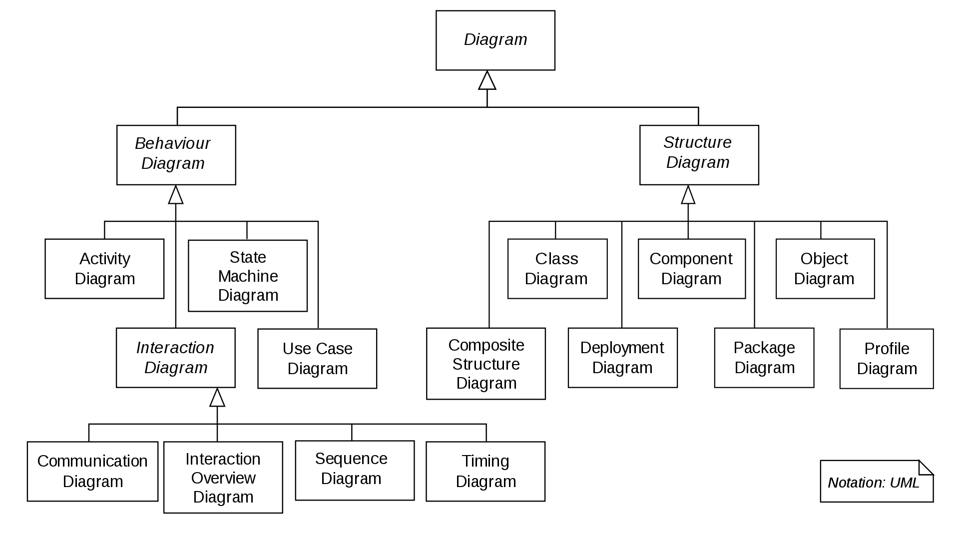
UML 2.X
UML 2.X
Collaboration Diagram

Slide 3
Use Case Diagram
Relate users, systems & tasks (relationship)… help identify boundary
Capture system functionality as seen by users
Developed by analysts & domain experts during requirements analysis
Specify the context of a system
Drive implementation & generate test cases

Slide 4
Use Case Diagram
Basis for a user-oriented approach to system development
Identify the users of the system (actors)
Identify the tasks they must undertake with the system (use cases)
Relate users & tasks (relationship)… help identify boundary

Slide 5
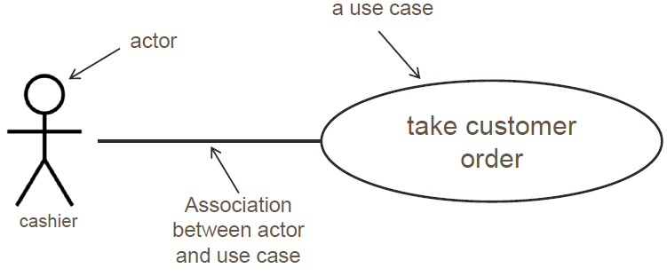
Writing Use Case Diagram in UML
Use cases: oval with text inside
Actors: stick figure
Relations: Dependencies, generalizations, associations
Order Coffee at a Coffee Shop from Cashier’s Perspective
Actors are really roles played by people. One person may play multiple roles. However, actors may also be another system.
Actors and use cases each have names.

Slide 6

Use Case Scenario: Order Coffee Through App
(start) Customer start app on his phone and logs in.
Customer picks preferred store.
Customer enters coffee choice.
App asks if “he would like anything else.”
Customer selects “checkout.”
App asks for payment.
Customer enters credit card number.
App validates the order.
Once done, App sends the order to the POS machine at preferred store and leaves a confirm message in the customer’s email inbox.
(end)
Notes:
Discussion

Slide 7

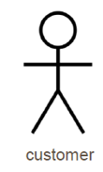




Use Case Scenario: Order Coffee Through App
(start) Customer start app on his phone and logs in.
Customer picks preferred store.
Customer enters coffee choice.
App asks if “he would like anything else.”
Customer selects “checkout.”
App asks for payment.
Customer enters credit card number.
App validates the order.
Once done, App sends the order to the POS machine at preferred store and leaves a confirm message in the customer’s email inbox.
(end)
Guide: actor action
Notes:
Discussion

Slide 8
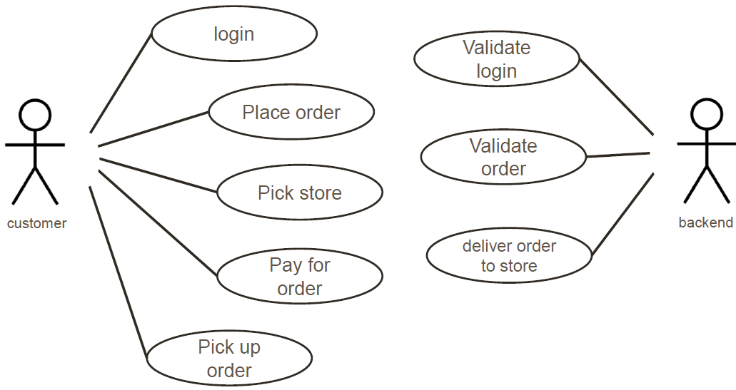
Writing Use Case Diagram in UML
CoffeeApp

Slide 9
Use Case Diagram Library System

Slide 10
How to find actors?
Observe direct users of the system- could be users or systems
What role do they play?
Who provides information to the system?
Who receives information from the system?
Actors could be:
Principal users
Secondary (External hardware, other systems, …)
Describe each actor clearly and precisely (semantics)
Short name
Description

Slide 11
How to find use cases?
Start with the list of actors and consider
What they need from the system (i.e. what use cases there are which have value for them)
Any other interactions they expect to interact with the system (i.e. which use cases they might take part in for someone’s else benefit)
How do you know what is a use case?
Estimate frequency of use, examine differences between use cases, distinguish between “basic” and “alternative” course of events & create new uses when necessary
Use case

Slide 12
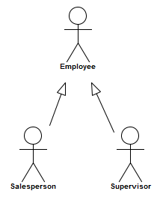
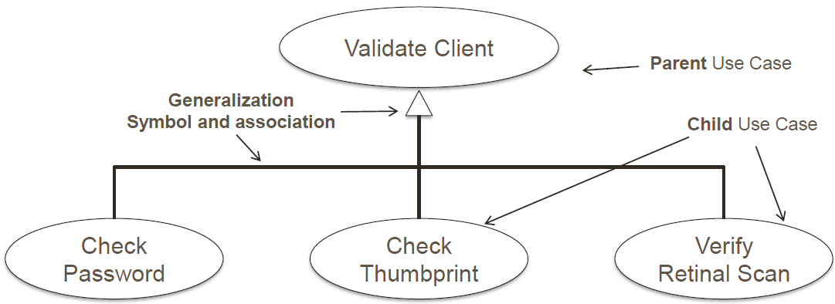
Relation: Use Case Generalization
Child use case inherits behavior and meaning from parent use case
Child may add or override parent behavior
Both actor and use case may be generalized.

Slide 13
Relation: Extending Use Cases
Efficient way to model optional system behavior and conditions.
The extending use case may add behavior to the base use case, but:
The Extended use case is meaningful on its own as it is independent of the extending use case.
Note: the direction of the arrow from
the less central case to the central one!

Slide 14
Relation: Extending Use Cases
<<extend>>
Fine is overdue

Slide 15
Relation: Extending Use Cases
Extensions can be also used for alternative/options: library member has fine to pay. S/he can select two options(paypal or credit/debit card)
Pay by Paypal
<<Extend>>
Option 1
selected
Select Payment
Options
Library member
Pay by credit/debit
Card
<<Extend>>
option 2 selected

Slide 16
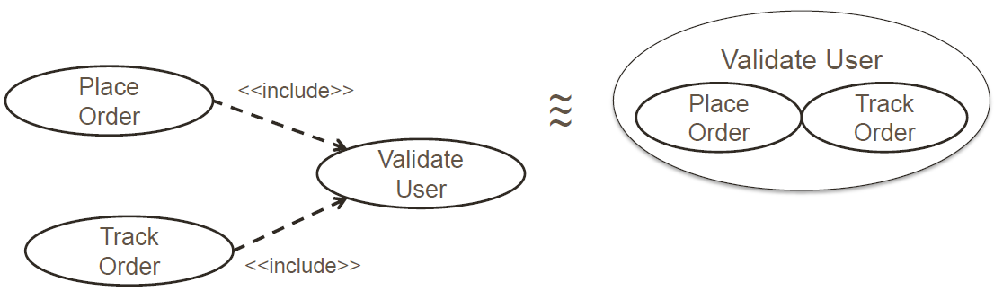
Relation: <<include>>
Avoid repetitive descriptions
Put common event flows into a use case of its own and then include it into the behavior of the (base) use case.
The include relationship is used to:
simplify large use case by splitting it into several use cases
represent common parts of the behaviors of other use cases
common functionality

Slide 17
Relation: <<include>>
Avoid repetitive descriptions
Put common event flows into a use case of its own and then include it into the behavior of the (base) use case.
The include relationship is used to:
simplify large use case by splitting it into several use cases
represent common parts of the behaviors of other use cases
common functionality

Slide 18
Example: <<include>>
Extend Loan
<<include>>
Check for
reservation
Borrow copy of a
book
<<include>>
Bookborrower

Slide 19
Guidelines for Choosing Relationships
Use <<include>> to show uses, complementary functionalities, logical dependencies, or avoiding repetition when you are repeating yourself in two or more separate use cases.
Use <<extend>> when you are an option, alternation on normal behavior, declaring your extension points in the base use case.
Use <<generalization>> when you are describing a variation on normal behavior, or inheritance relations.
(taken from Martin Fowler’s UML Distilled)

Slide 20
Use case and actor description
Example:
Borrow copy of book
A book borrower presents a book. The system checks that the potential borrower is a member of the library & she does not have the maximum number of books
BookBorrower
This actor represents some one that make
use of the library for borrowing books
Borrow a copy
of book
BookBorrower

Slide 21
Use case and actor description
Writing a specification for the use case
Good Practice
Preconditions: the system state before the case begin (i.e., facts, things that must be true)
Flow of events; the steps in the use case (i.e. actions…)
Postconditions: the system state after the case has been completed
Borrow a copy
of book
BookBorrower

Slide 22
Relation: Extending Use Cases
<<extend>>
Fine is overdue

Slide 23
Use case and actor description
Borrow a copy of book
Precondition
1. the BookBorrower is a member of the library
2. the BookBorrower has not got more than the permitted number of books on loan
Flow of events
1. the use case starts when the BookBorrower attempts to borrow a book
2. the librarian checks it is ok to borrow a book
3. If …… (indicate an alternative path of action)
Post-conditions
1. the system has updated the number of books the BookBorrower has on loan
Borrow a copy
of book
BookBorrower

Slide 24
Scenario Description
Each time an actor interacts with a system, the triggered use cases instantiate a scenario
Each case corresponds to a specific path through a use case with no branching
Scenarios are typically documented as text along side the use case and activity diagrams
Borrow a copy
of book
BookBorrower

Slide 25
Scenario Description
Scenario 1
BookBorrower Joe B Borrows the library’s only copy of using UML, when he has no other book on loan. The system is updated accordingly.
Scenario 2
BookBorrower Ann tries to borrow the library’s second copy of Software Engineering, but is refused because she has six books out on loan, which is her maximum allowance.

Slide 26
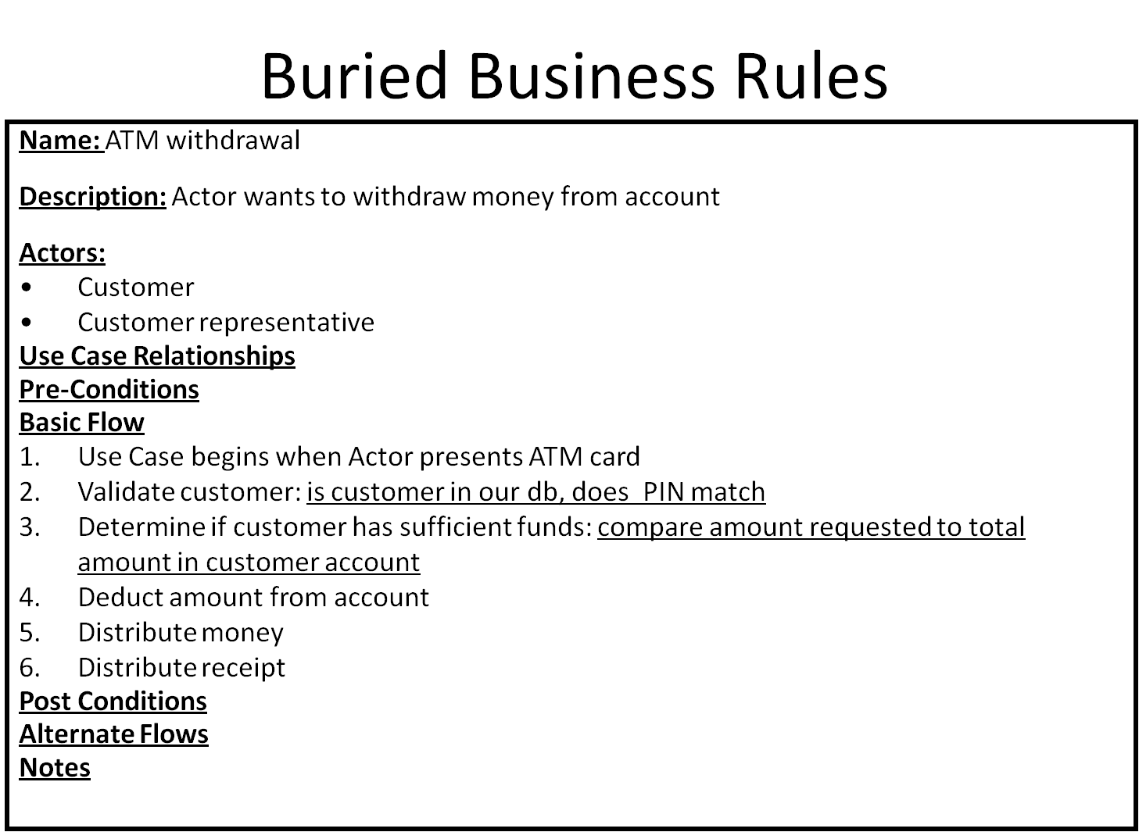
Use Case Specification
Each Use Case shown in a diagram should be accompanied by a textual specification
➢Use Case name
➢Actors
➢Entry Condition (pre-)
➢Normal behavior
➢Exceptions
➢Exit Condition (post-)
➢Special Requirements (e.g. non-functional requirements)

Slide 27
Summary
Use cases help understand the functional requirements of a system.
Use cases represent an external view of the system. Thus, don’t expect any correlations between use cases and the classes inside the system.
A first pass at use cases should be made early on (in requirement stage).
More detailed versions of use cases could be worked just prior to developing that use case.
Don’t need to make your use case diagram too complicated. Find a balance.

Slide 28
Exercise: SmartBank
Read the SmartBank description, and draw 2 use case diagrams:
1) One diagram should depict your entire system;
2) Second diagram should explain a critical/complicated process of the system e.g. deposit and transfer money.
Overview of banking systems
SmartBank is an online banking system that allows the customer to perform all the available actions through an ATM screen. The system can also be accessed by bank staff to perform the actions through cashiers. The system should provide basic operations such as deposit money, withdraw money, transfer money and agree to make loans to their customers. The bank cashiers can create new bank accounts to customers, search for customers’ accounts, update/view customer personal details and close customers bank account.

Slide 29

Use case diagram for the entire system
Search account
<<extend>>
Withdraw
<<extend>>
View details
Update details
Deposit
Transfer
customers
Make loan
Cashier
Open account
Close account

Slide 30
Cash Withdrawal
Validate User
<<include>>
Login account
Choose option
Check Balance
<<include>>
Enter amount
<<extend>>
customers
Enter other service
Not enough money
End transaction

Slide 31
Your tasks after the lecture
Further improve the use case diagram for the entire system.
Draw the detailed use case diagram for a critical/complicated process of the system.

